Slide 1


Proof of concept Presentation
Group A

Slide 2
Architecture
Home Base
Mobile Base
Drones

Slide 3
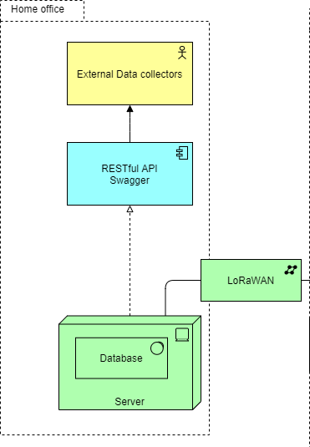
Home Base
Cloud Firestore database
Restful Swagger API
Collects data from Mobile base
Allows requests for gathered data

Slide 4
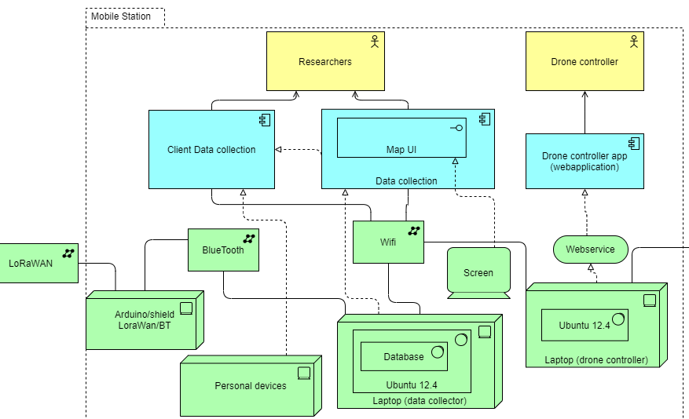
Mobile Base

Slide 5
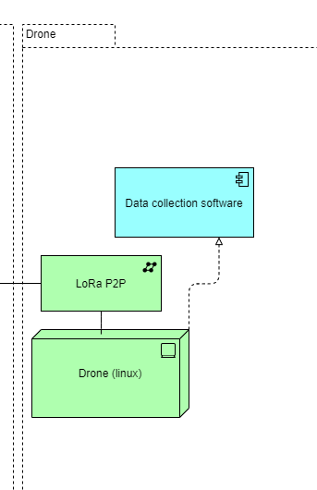
Drones
JMAVsim
Simulated on linux environment
LoraP2P communication with mobile base

Slide 6
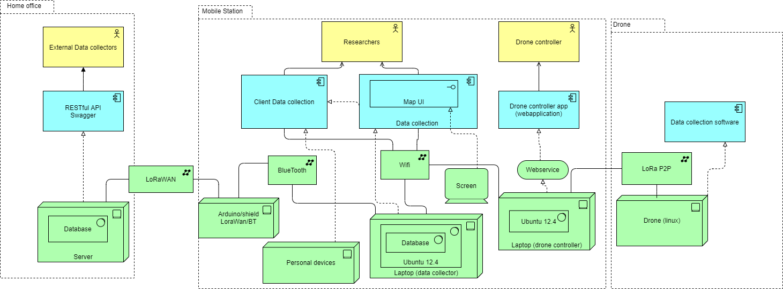
Whole Architecture

Slide 7
definition An RFC is authored by individuals or groups of engineers and computer scientists in the form of a memorandum describing methods, behaviors, research, or innovations applicable to the working of the Internet and Internet-connected systems. Many RFCs are informational or experimental in nature and are not standards. The RFC system was invented by Steve Crocker in 1969 to help record unofficial notes on the development of ARPANET.
RFC (REQUEST FOR COMMENTS)

Slide 8
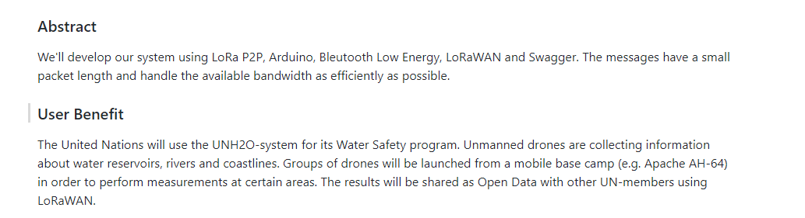

Slide 9
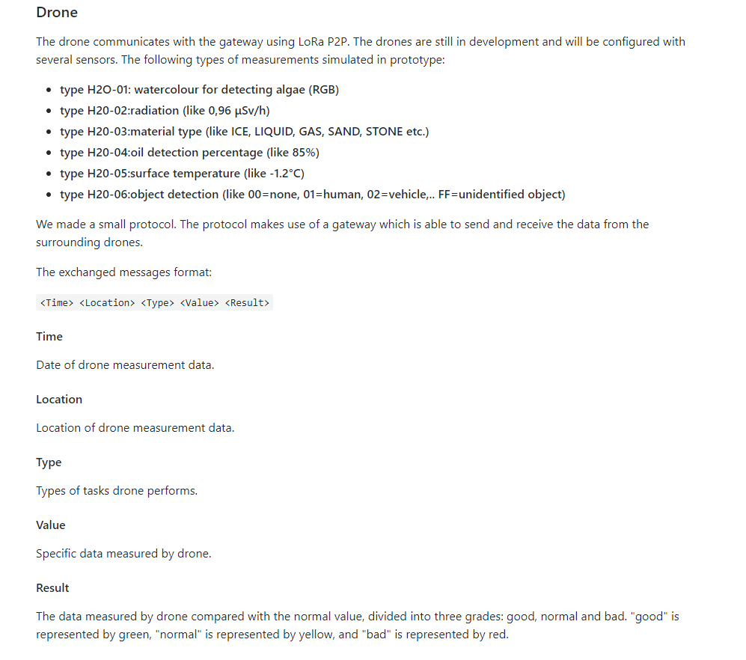

Slide 10
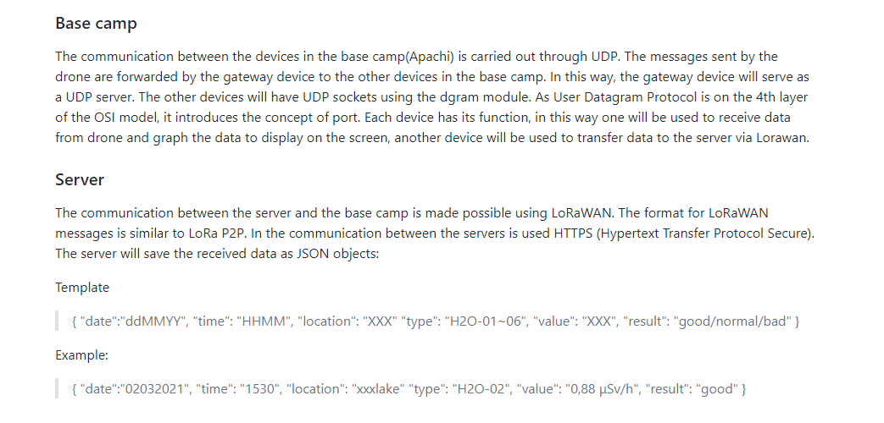

Slide 11
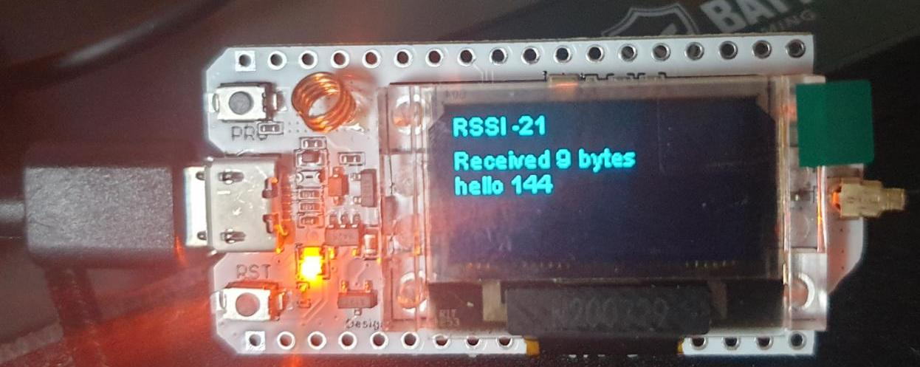
LoRa
Received 2x LoRA ESP32
1 Imitates a drone (collects and sends the data)
2. Imitates a basecamp (receives data)

Slide 12
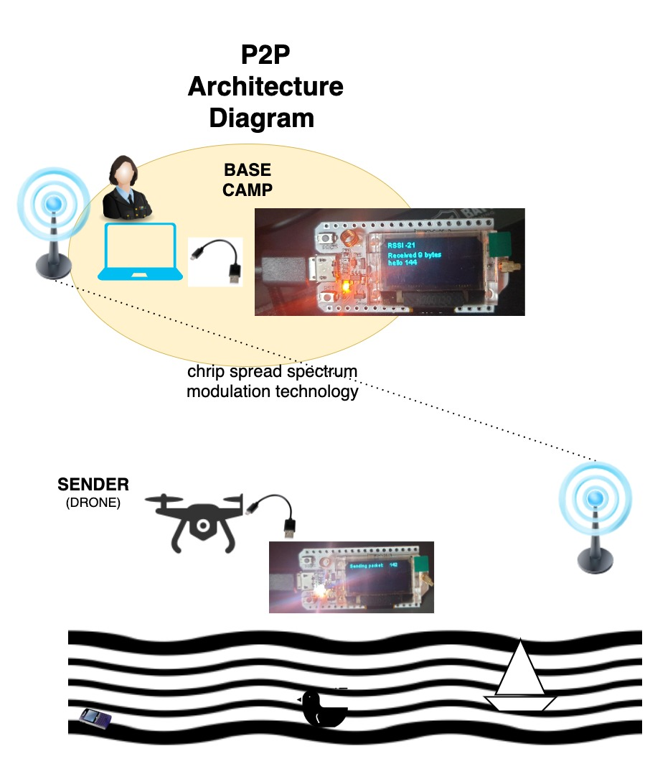

Slide 13
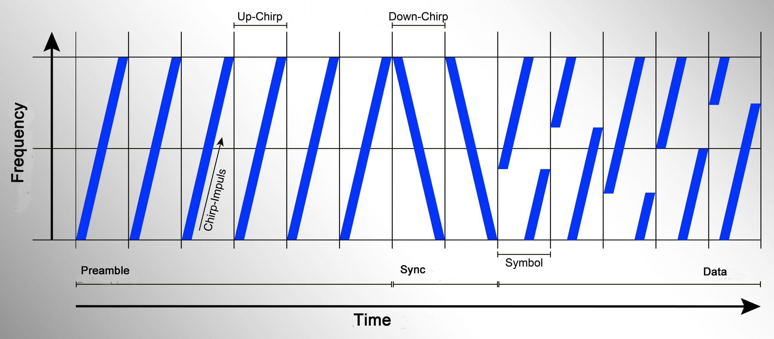
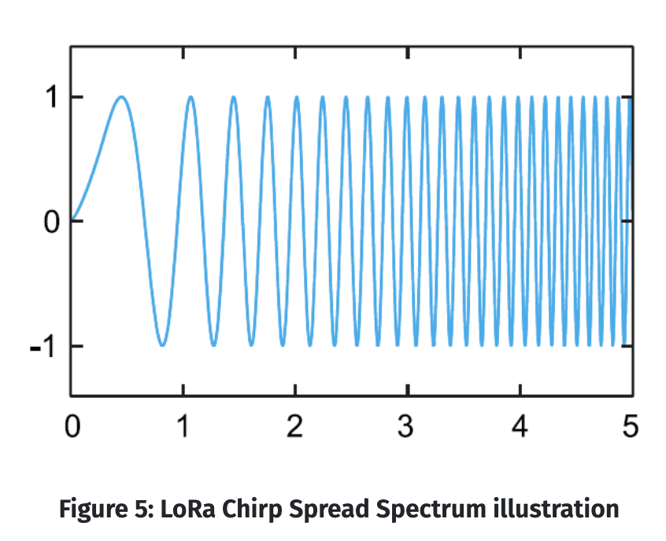
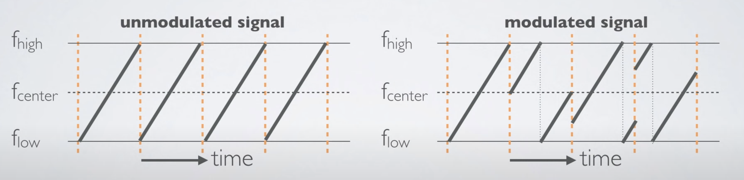
Lora’s communication
Getaways are connected to network via standard IP connectins
-> converting RF (radio frequency) packets to IP packets and vice versa

Slide 14
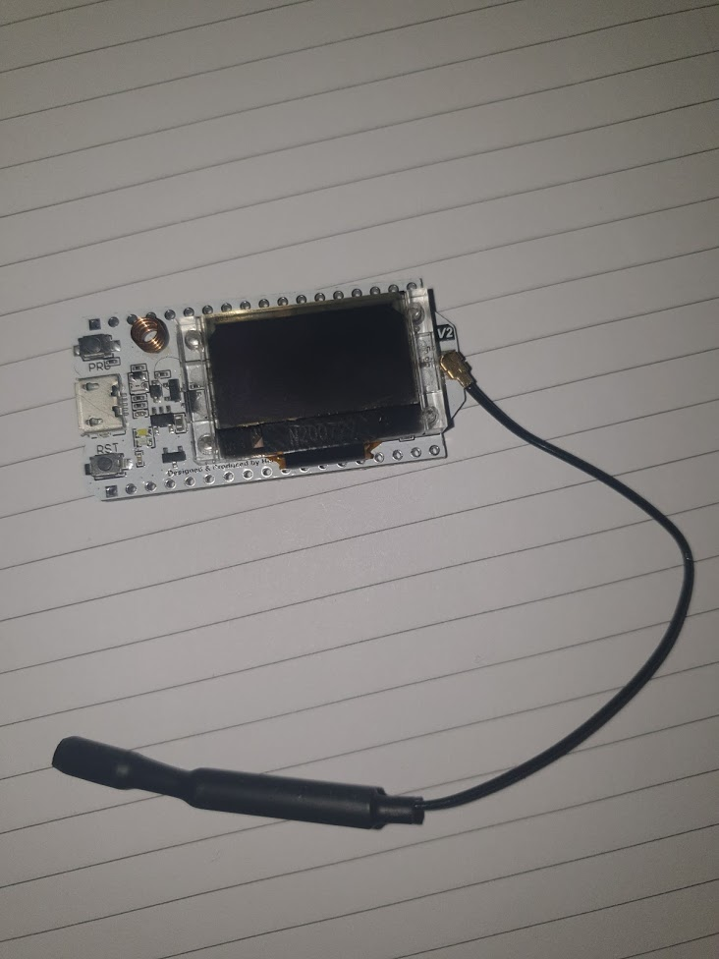

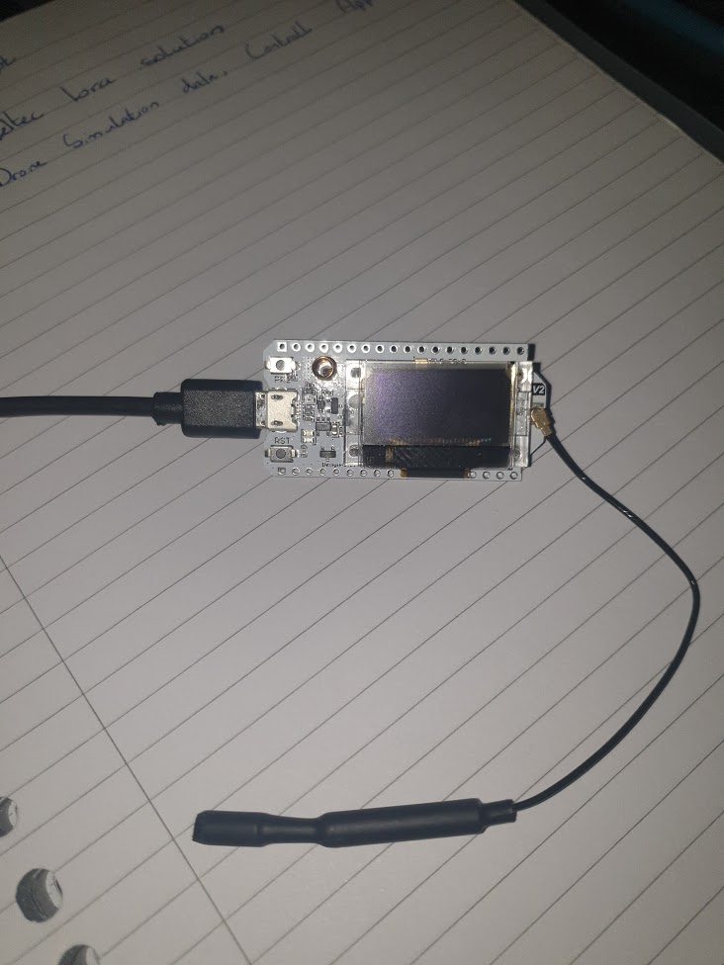
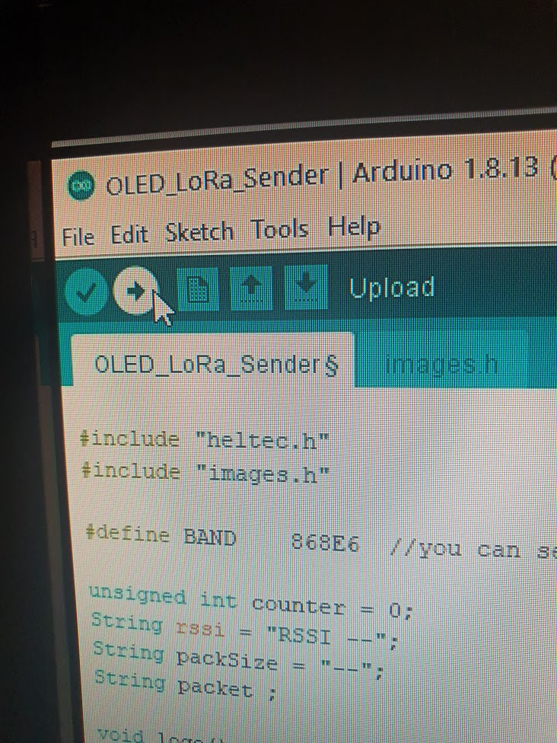
HELTEC ESP32 Setup
Install Arduino drivers/ide
connect heltec esp32 with cable to computer (sender & receiver)
Select com port
Choose board type in ide
attach antenna to the heltec esp32
Upload programs to heltec devices (Sender & Receiver)

Slide 15
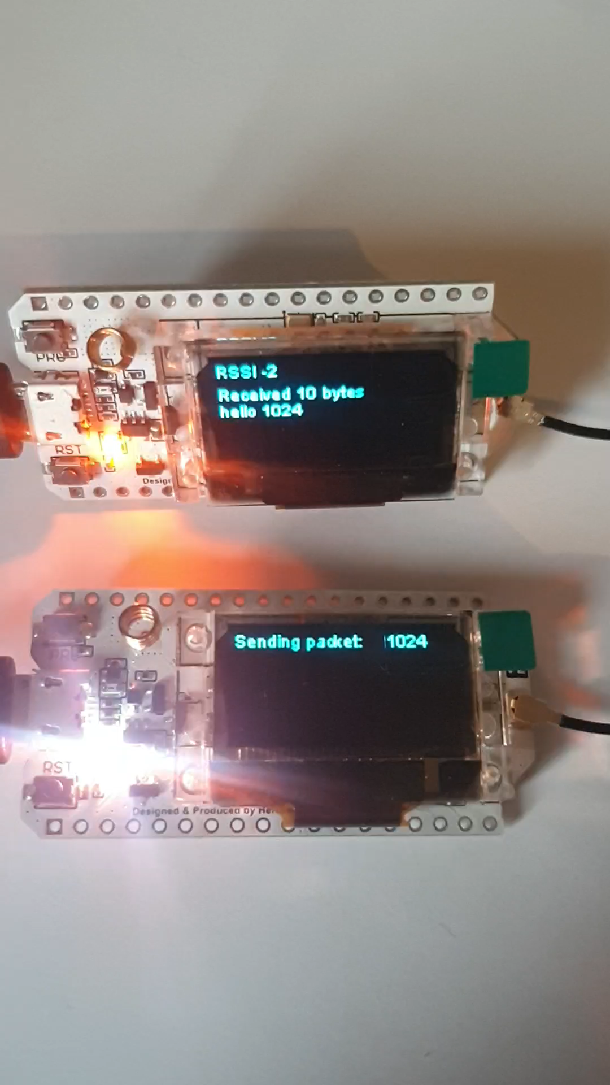
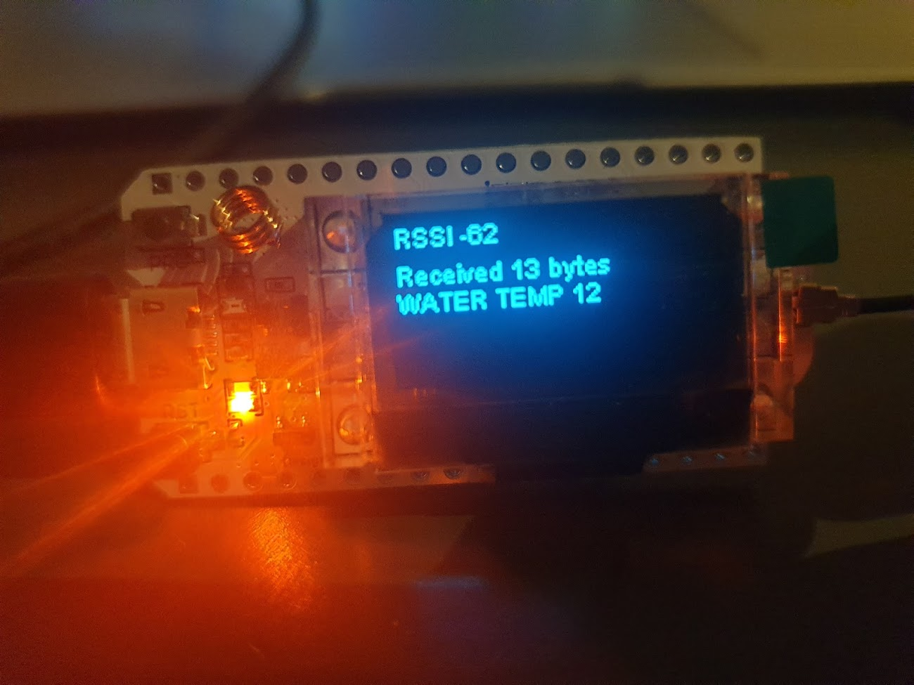
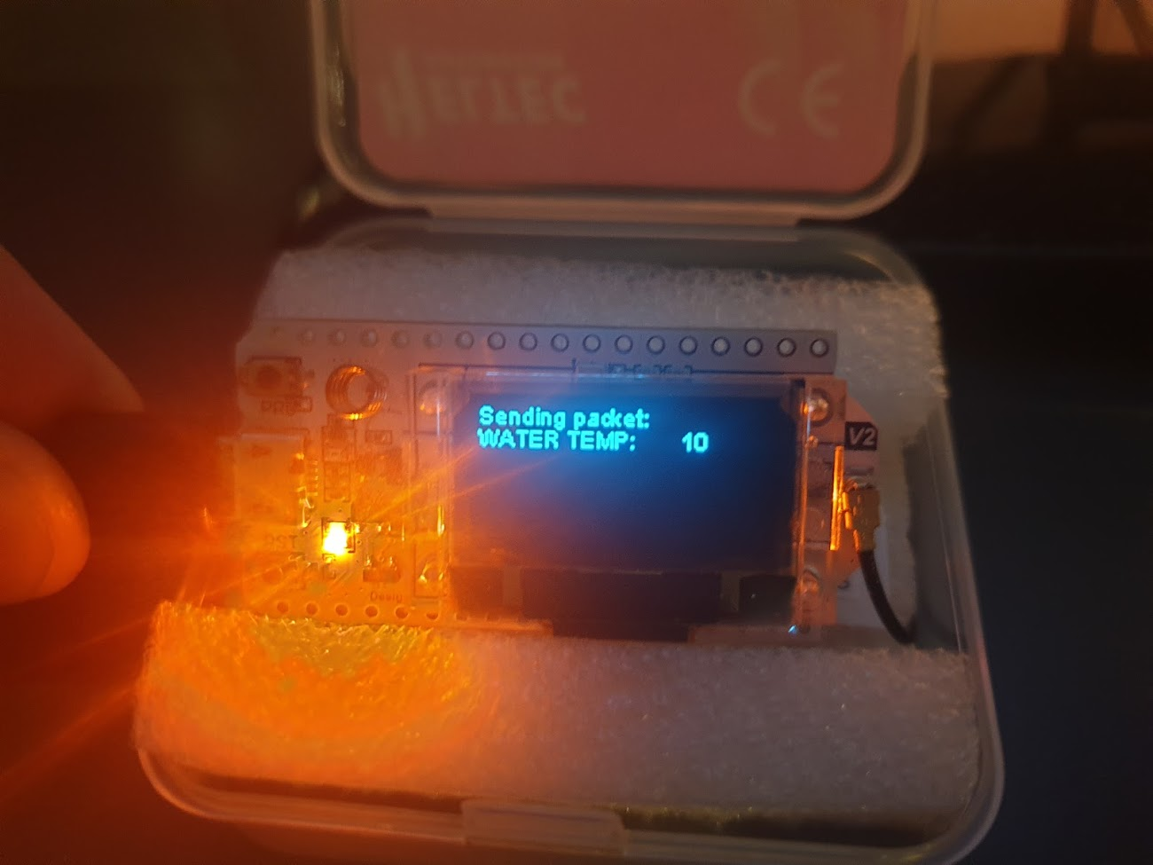
HELTEC ESP32 COMMUNICATION
- BASECAMP
- DRONE
Notes:
RSSI: Received signal strength indication ( 0 = best | -100 = worst )

Slide 16
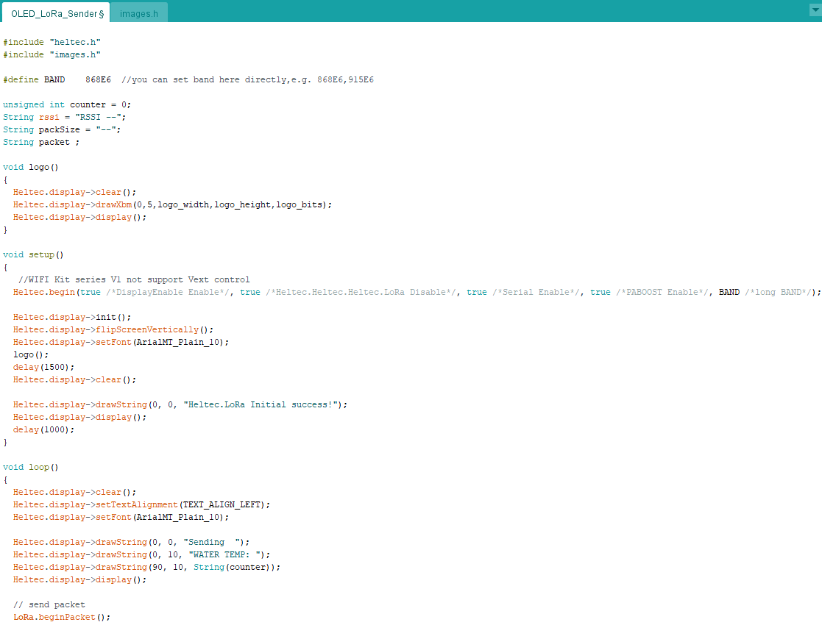
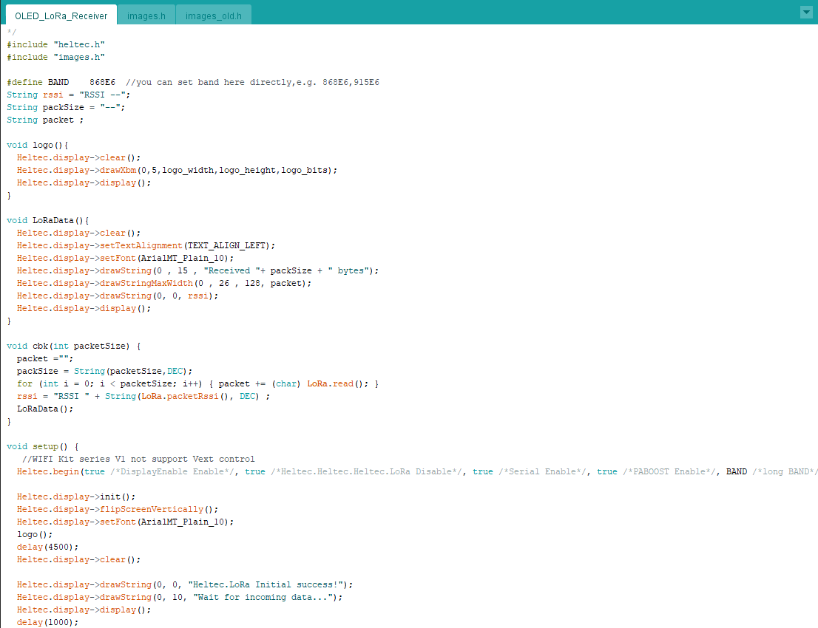
SENDER / RECEIVER PROGRAMS
Notes:
C++
Include the heltec.h

Slide 17
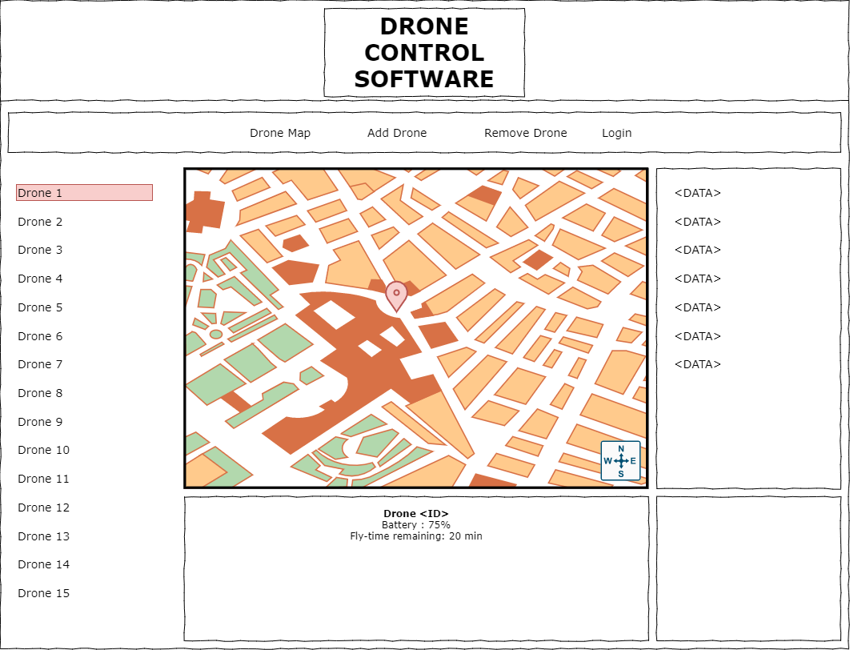
Application Wireframe
Multiple drones
Live data feed
Location on map (optional)
Send drone next coordinate
Enter drone coordinates
send

Slide 18

drone Data collection
Database choice: firebase
cloud based: Easy data accessibility
No-sql
compatible to our project
real time data

Slide 19
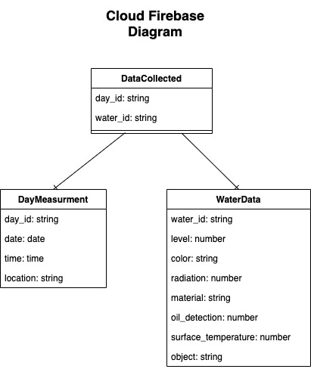

Slide 20
HC-05 bluetooth settings
Serial module for Arduino and other microcontrollers
Default name: "HC-05"
Default Communication: Slave, can operate also in Master or Master/Slave mode
Operating voltage: 3V to 6V (typically +5V)
Range: <100m
Easily interfaced with laptop or mobile phone

Slide 21
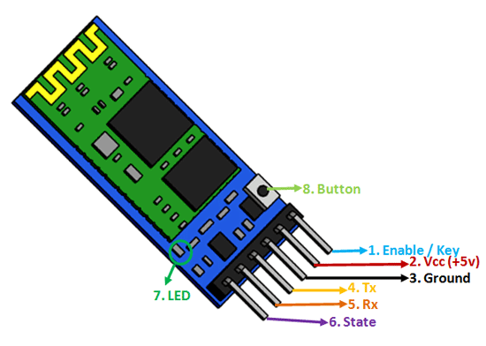
HC-05 bluetooth pins
1 Enable / Key – toggle between Data Mode (set low) and AT command mode (set high)
2 VCC – Powers the module
3 Ground – ground pin of the module
4 TX – transmitter – transmits Serial Data
5 RX – receiver – Receive Serial Data
6 State – used as a feedback
7 LED – indicates the status of Module
8 Button – used to control the Key/Enable pin

Slide 22
Where to use HC-05 Bluetooth module
Communication between two microcontrollers like Arduino
Communication with any device with bluetooth functionality like a Phone or Laptop
The module communicates with the help of USART at 9600 baud rate = easy to interface with any microcontroller that supports USART
Wireless module that can transfer data from the computer or mobile phone to microcontroller or vice versa

Slide 23
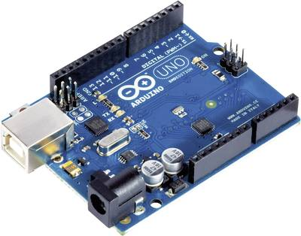
Arduino
Open-source electronic platform based on easy-to-use hardware and software
Board can interact with buttons, LEDs, motors, speakers, GPS units, cameras, smartphone or even TV
Can be used as the electronic brain for different kinds of robots, monitoring and security systems, or various kinds of displays

Slide 24
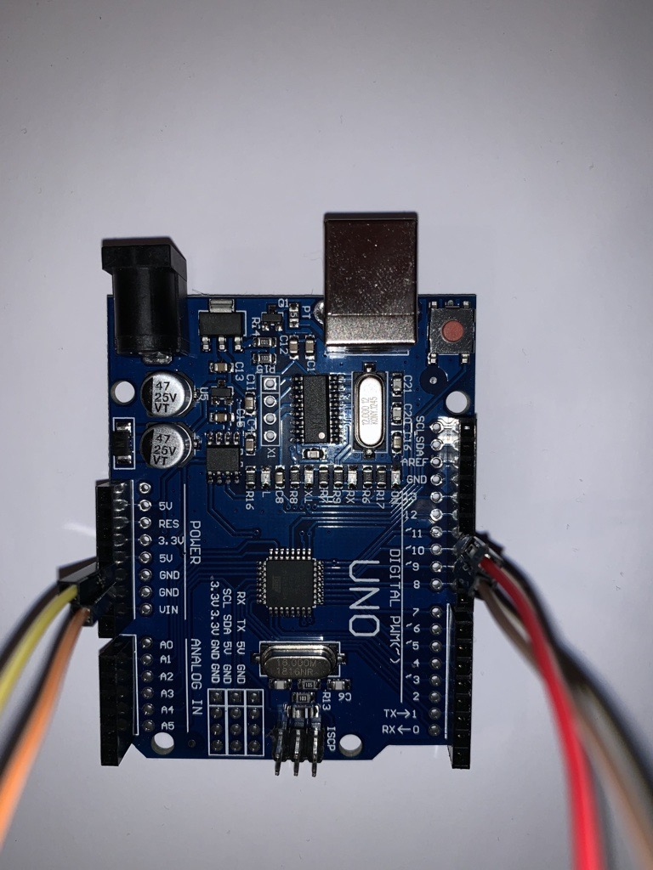
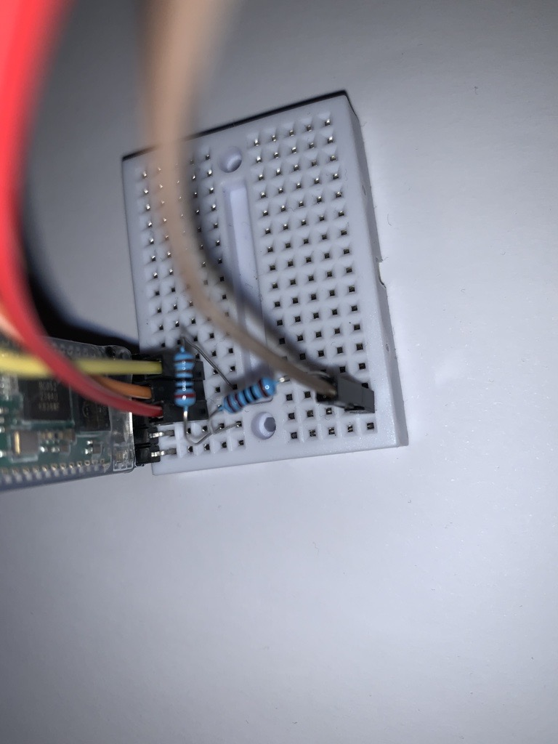
Wiring Set-up
Connection from Bluetooth module to arduino
RX -> TX
TX -> RX
GND -> GND
VCC -> 5V

Slide 25
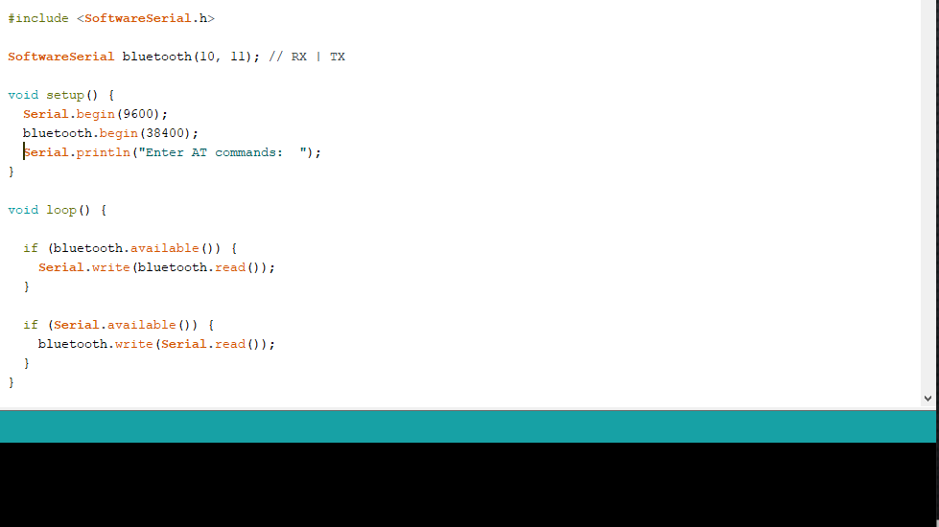

Slide 26
Swagger
Open API
Swagger Hub
Swagger inspector
Swagger UI

Slide 27
Open API
Required specification for Swagger
Used for http systems (Most often RESTful APIs)
Supports YAML and JSON (YAML preferred)

Slide 28
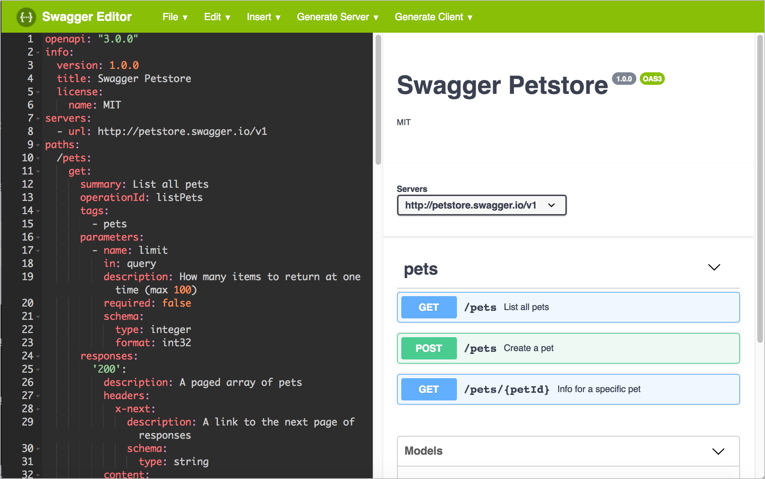
Swagger Hub
Platform for designing RESTful APIs
Uses Swagger Editor to display output from specification
Displays all possible requests from designed specification
Project can be modified by multiple users with access (think gitlab)

Slide 29
Swagger Inspector
Easily make RESTful requests from API and view result in browser
All requests are logged for easy revisit
Requests made can selected to generate new specification from

Slide 30
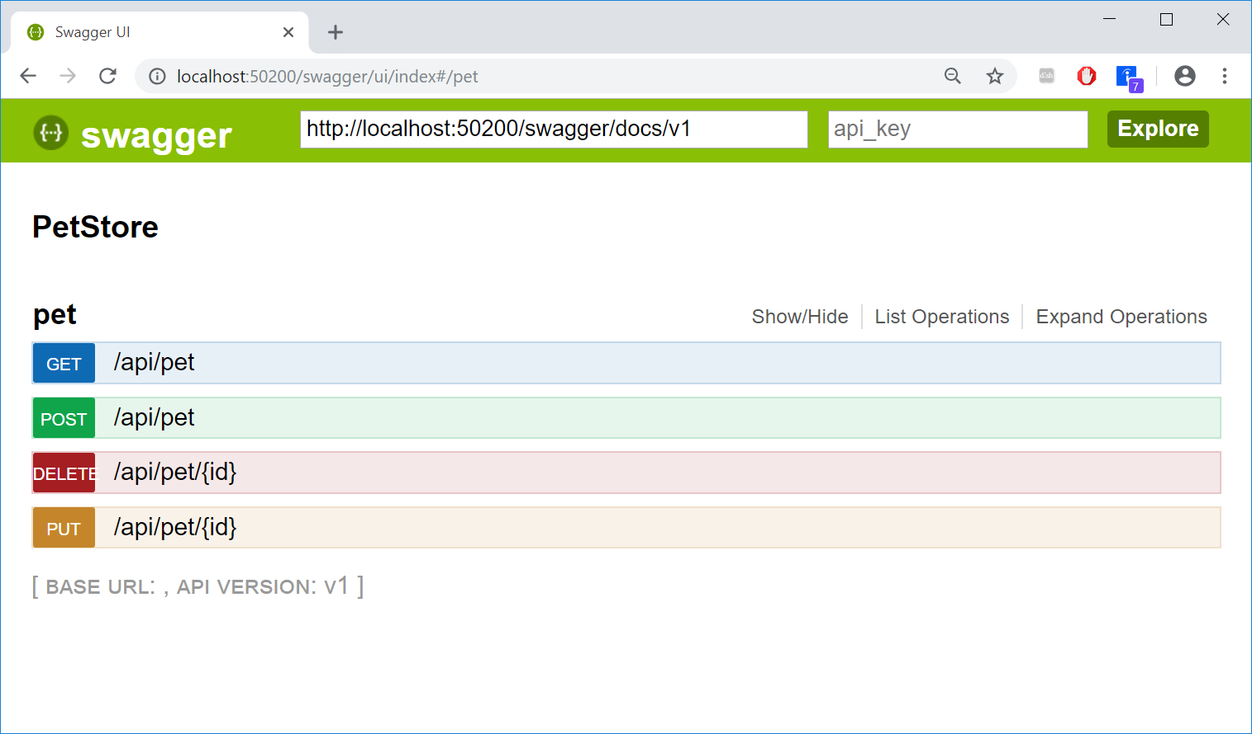
Swagger UI
HTML based automatically generated documentation
JSON support
Interactive interface
View all possible end points and search parameters from specification

Slide 31
Resources
Content
https://www.everythingrf.com/community/what-is-lora
https://blog.paessler.com/what-is-lora-a-beginners-guide-part-1
https://www.semtech.com/lora/what-is-lora
https://metova.com/understanding-lora-basics-a-non-technical-explanation/
https://www.i-scoop.eu/internet-of-things-guide/lpwan/iot-network-lora-lorawan/
https://lora-alliance.org/
https://en.wikipedia.org/wiki/LoRa
https://learn.sparkfun.com/tutorials/what-is-an-arduino/all
https://swagger.io/
Images
https://quadmeup.com/testing-868mhz-lora-range-part-3-round-trip/
https://www.digitalmatter.com/applications/features/lorawan-introduction/
https://en.wikipedia.org/wiki/LoRa
https://iqnexus.com/lpwan-devices/gateways/indoor-femto-gateway-lorawan
https://en.wikipedia.org/wiki/Arduino
https://www.instructables.com/Setting-Up-Bluetooth-HC-05-With-Arduino/
https://wiki.dragino.com/index.php?title=Lora_Shield

